Slide 1
Wander Join: Online Aggregation via Random Walks
Feifei Li Bin Wu, Ke Yi Zhuoyue Zhao
University of Utah Hong Kong University Shanghai Jiao Tong
of Science and Technology University

Slide 2
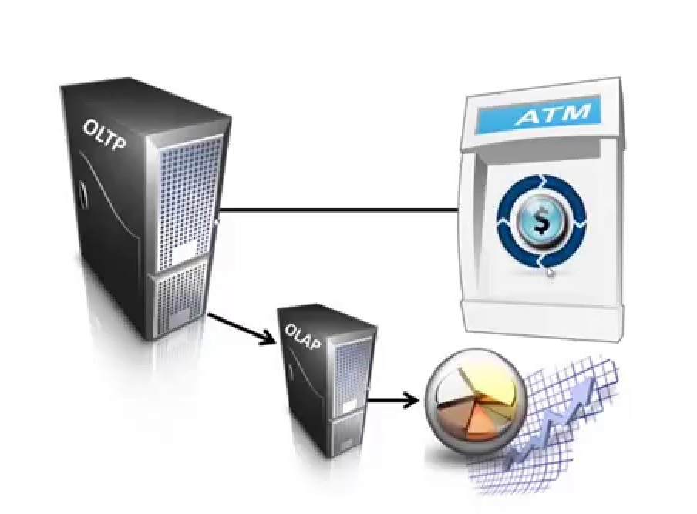
Database Workloads
Transactional (OLTP)
Deduct $x$ dollars from account A, credit $x$ dollars to account B
Challenge: Efficiency and correctness (ACID)
Analytical (OLAP)
Large fraction of data
Many tables
Complex conditions
Challenge: Efficiency
Correctness?

Slide 3
Complex Analytical Queries (TPC-H)
SELECT SUM(l_extendedprice * (1 - l_discount))
FROM customer, lineitem, orders, nation, region
WHERE c_custkey = o_custkey
AND l_orderkey = o_orderkey
AND l_returnflag = 'R'
AND c_nationkey = n_nationkey
AND n_regionkey = r_regionkey
AND r_name = 'ASIA'
This query finds the total revenue loss due to returned orders in a given region.

Slide 4

Online Aggregation [Haas, Hellerstein, Wang, SIGMOD’97]
SELECT ONLINE SUM(l_extendedprice * (1 - l_discount))
FROM customer, lineitem, orders, nation, region
WHERE c_custkey = o_custkey
AND l_orderkey = o_orderkey
AND l_returnflag = 'R'
AND c_nationkey = n_nationkey
AND n_regionkey = r_regionkey
AND r_name = 'ASIA'
WITHTIME 60000 CONFIDENCE 95 REPORTINTERVAL 1000
Confidence interval: $\operatorname{Pr}\left[\tilde{Y}−ε<Y<\tilde{Y}+ε\right]>0.95$
$$\tilde{Y}+ε$$
$$\tilde{Y}$$
$$\tilde{Y}−ε$$

Slide 5
Ripple Join [Haas, Hellerstein, SIGMOD’99]
Store tuples in each table in random order
In each step
Reads the next tuple from a table in a round-robin fashion
Join with sampled tuples from other tables
Works well for full Cartesian product
But most joins are sparse …

Slide 6
A Running Example
Nation | CID
US | 1
US | 2
China | 3
UK | 4
China | 5
US | 6
China | 7
UK | 8
Japan | 9
UK | 10
BuyerID | OrderID
4 | 1
3 | 2
1 | 3
5 | 4
5 | 5
5 | 6
3 | 7
5 | 8
3 | 9
7 | 10
OrderID | ItemID | Price
4 | 301 | $2100
2 | 304 | $100
3 | 201 | $300
4 | 306 | $500
3 | 401 | $230
1 | 101 | $800
2 | 201 | $300
5 | 101 | $200
4 | 301 | $100
2 | 201 | $600
What’s the total revenue of all orders from customers in China?
$N$: size of each table, e.g., ${10}^{9}$
$n$: # tuples taken from each table
$s$: # estimators, e.g., ${10}^{3}$
$$n^{3}⋅\frac{1}{N^{2}}=s$$
$$n=N^{2/3}s^{1/3}={10}^{7}$$

Slide 7
Join as a Graph
$R_{1}$ $R_{2}$ $R_{3}$
Conceptual only
Never materialized

Slide 8
Join as a Graph
$R_{1}$ $R_{2}$ $R_{3}$
Conceptual only
Never materialized

Slide 9
Join as a Graph
Nation | CID
US | 1
US | 2
China | 3
UK | 4
China | 5
US | 6
China | 7
UK | 8
Japan | 9
UK | 10
BuyerID | OrderID
4 | 1
3 | 2
1 | 3
5 | 4
5 | 5
5 | 6
3 | 7
5 | 8
3 | 9
7 | 10
OrderID | ItemID | Price
4 | 301 | $2100
2 | 304 | $100
3 | 201 | $300
4 | 306 | $500
3 | 401 | $230
1 | 101 | $800
2 | 201 | $300
5 | 101 | $200
4 | 301 | $100
2 | 201 | $600
SELECT SUM(Price)
FROM Customers C,
Orders O,
Items I
WHERE
C.Nation = ‘China’
C.CID = O.BuyerID
O.OrderID =
I.OrderID

Slide 10
Sampling by Random Walks
Nation | CID
US | 1
US | 2
China | 3
UK | 4
China | 5
US | 6
China | 7
UK | 8
Japan | 9
UK | 10
BuyerID | OrderID
4 | 1
3 | 2
1 | 3
5 | 4
5 | 5
5 | 6
3 | 7
5 | 8
3 | 9
7 | 10
OrderID | ItemID | Price
4 | 301 | $2100
2 | 304 | $100
3 | 201 | $300
4 | 306 | $500
3 | 401 | $230
1 | 101 | $800
2 | 201 | $300
5 | 101 | $200
4 | 301 | $100
2 | 201 | $600
SELECT SUM(Price)
FROM Customers C,
Orders O,
Items I
WHERE
C.Nation = ‘China’
C.CID = O.BuyerID
O.OrderID =
I.OrderID

Slide 11
Sampling by Random Walks
Nation | CID
US | 1
US | 2
China | 3
UK | 4
China | 5
US | 6
China | 7
UK | 8
Japan | 9
UK | 10
BuyerID | OrderID
4 | 1
3 | 2
1 | 3
5 | 4
5 | 5
5 | 6
3 | 7
5 | 8
3 | 9
7 | 10
OrderID | ItemID | Price
4 | 301 | $2100
2 | 304 | $100
3 | 201 | $300
4 | 306 | $500
3 | 401 | $230
1 | 101 | $800
2 | 201 | $300
5 | 101 | $200
4 | 301 | $100
2 | 201 | $600
SELECT SUM(Price)
FROM Customers C,
Orders O,
Items I
WHERE
C.Nation = ‘China’
C.CID = O.BuyerID
O.OrderID =
I.OrderID

Slide 12
Sampling by Random Walks
Nation | CID
US | 1
US | 2
China | 3
UK | 4
China | 5
US | 6
China | 7
UK | 8
Japan | 9
UK | 10
BuyerID | OrderID
4 | 1
3 | 2
1 | 3
5 | 4
5 | 5
5 | 6
3 | 7
5 | 8
3 | 9
7 | 10
OrderID | ItemID | Price
4 | 301 | $2100
2 | 304 | $100
3 | 201 | $300
4 | 306 | $500
3 | 401 | $230
1 | 101 | $800
2 | 201 | $300
5 | 101 | $200
4 | 301 | $100
2 | 201 | $600
SELECT SUM(Price)
FROM Customers C,
Orders O,
Items I
WHERE
C.Nation = ‘China’
C.CID = O.BuyerID
O.OrderID =
I.OrderID

Slide 13
Sampling by Random Walks
Nation | CID
US | 1
US | 2
China | 3
UK | 4
China | 5
US | 6
China | 7
UK | 8
Japan | 9
UK | 10
BuyerID | OrderID
4 | 1
3 | 2
1 | 3
5 | 4
5 | 5
5 | 6
3 | 7
5 | 8
3 | 9
7 | 10
OrderID | ItemID | Price
4 | 301 | $2100
2 | 304 | $100
3 | 201 | $300
4 | 306 | $500
3 | 401 | $230
1 | 101 | $800
2 | 201 | $300
5 | 101 | $200
4 | 301 | $100
2 | 201 | $600
SELECT SUM(Price)
FROM Customers C,
Orders O,
Items I
WHERE
C.Nation = ‘China’
C.CID = O.BuyerID
O.OrderID =
I.OrderID
$N$: size of each table size, e.g., ${10}^{9}$
$n$: # tuples taken from each table = # random walks
$s$: # estimators, e.g., ${10}^{3}$
$$n=s={10}^{3}$$
Unbiased estimator: $\frac{\$500}{sampling prob.}=\frac{\$500}{1/3⋅1/4⋅1/3}$

Slide 14
Walk Plan Optimization
$R_{1}$ $R_{2}$ $R_{3}$
Structure of the data graph
Selection predicates
Starting table: use index
Table in the middle: reject random walk
Data distribution
Non-uniformity may not be a bad thing!
$R_{1}$ $R_{2}$
$R_{1}$ $R_{2}$
1
1
1
1
5
6
3
0
5
6
3
0
1
1
1
1
$$Var\left[R_{1}→R_{2}\right]<Var\left[R_{2}→R_{1}\right]$$
$$Var\left[R_{1}→R_{2}\right]>Var\left[R_{2}→R_{1}\right]$$

Slide 15
Walk Plan Optimizer
Enumerate all plans
Conduct ~ 100 trial random walks using each plan
Measure the variance of each plan
Select the best plan
All trials runs are still useful

Slide 16
Convergence Comparison

Slide 17
Wander Join in PostgreSQL
Logarithmic growth due to B-tree lookup to find random neighbours

Slide 18
Running on Insufficient Memory (4GB)
Insufficient memory incurs a heavy, one-time penalty
Growth is still logarithmic
Fundamentally: Random sampling at odds with hard disks
But does it matter? Spark, In-Memory DB, RAM cloud…
The algorithm is embarrassingly parallel
Turbo DBO [Dobra, Jermaine, Rusu, Xu, VLDB’09]

Slide 19
Accuracy Achieved in 1/10 Time of Full Join

Slide 20
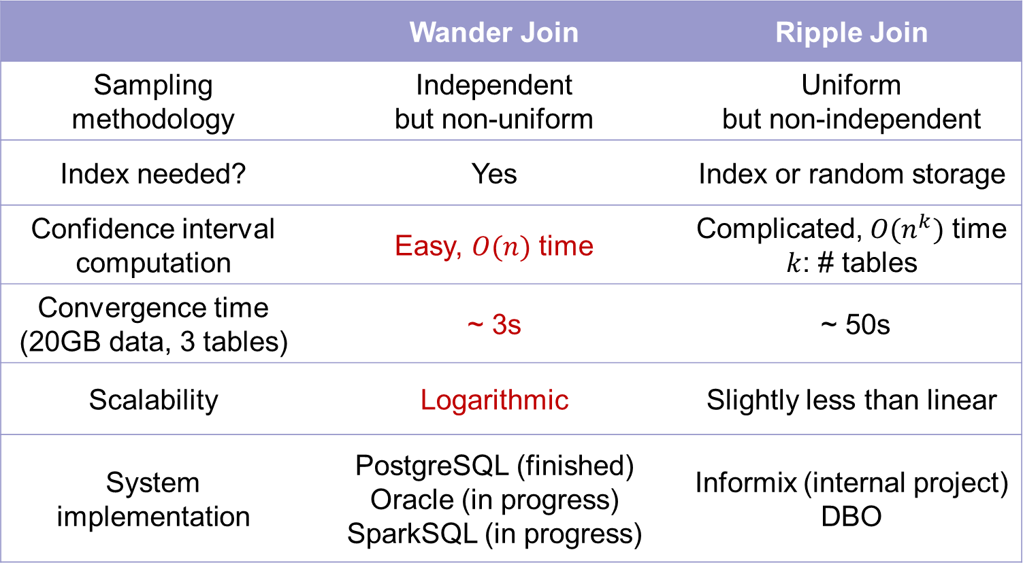
Wander Join vs Ripple Join
 | Wander Join | Ripple Join
Sampling methodology | Independent but non-uniform | Uniform but non-independent
Index needed? | Yes | Index or random storage
Confidence interval computation | Easy, $O(n)$ time | Complicated, $O(n^{k})$ time $k$: # tables
Convergence time (20GB data, 3 tables) | ~ 3s | ~ 50s
Scalability | Logarithmic | Slightly less than linear
System implementation | PostgreSQL (finished) Oracle (in progress) SparkSQL (in progress) | Informix (internal project) DBO

Slide 21
Online Aggregation vs Data Cube
 | Online Aggregation | Data Cube
Queries | Online, ad hoc | Offline, fixed
Latency | Seconds | Hours, then milliseconds
Query mode | One at a time | Batch
Accuracy | Small error | No error
Data schema | Any (relational, graph) | Multidimensional cube
Work with OLTP | Integrated | Separate
Target scenario | Online, ad hoc, interactive data analytics | Monthly report

Slide 22
Thank you!

Slide 23
Index Ripple Join [Lipton, Naughton, Schneider, SIGMOD’90]
Nation | CID
US | 1
US | 2
China | 3
UK | 4
China | 5
US | 6
China | 7
UK | 8
Japan | 9
UK | 10
BuyerID | OrderID
4 | 8
3 | 5
1 | 3
5 | 4
5 | 2
5 | 3
3 | 7
5 | 1
3 | 9
7 | 10
OrderID | ItemID | Price
4 | 301 | $2100
2 | 304 | $100
3 | 201 | $300
4 | 306 | $500
3 | 401 | $230
1 | 101 | $800
2 | 201 | $300
5 | 101 | $200
4 | 301 | $100
2 | 201 | $600

Slide 24
Sampling from a B-tree [Olken, ’93]
4
3
2
Sampling from an aggregate (ranked) B-tree is easy
But
incurs heavy cost for transactions
need to modify existing B-tree implementations

Slide 25
Rejection Sampling [Olken, ’93]
Imagine each node has maximum fanout
Reject as soon as it walks out of bound

Slide 26
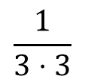
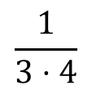
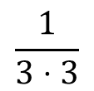
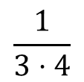
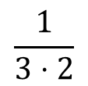
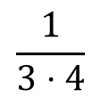
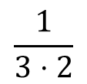
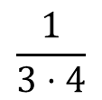
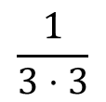
Non-Uniform Sampling
$$\frac{1}{3⋅4}$$
$$\frac{1}{3⋅4}$$
$$\frac{1}{3⋅4}$$
$$\frac{1}{3⋅4}$$
$$\frac{1}{3⋅2}$$
$$\frac{1}{3⋅2}$$
$$\frac{1}{3⋅3}$$
$$\frac{1}{3⋅3}$$
$$\frac{1}{3⋅3}$$
As long as we can compute the sampling probability, wander join still works!

Slide 27
Compare with BlinkDB [Agarwal, Mozafari, Panda, Milner, Madden, Stoica, ’13]
 | Wander Join | BlinkDB
Methodology | Query → Sampling | Sampling → Query
Sampling method | Random walks | Stratified sampling
Joins supported | Any | Big table joining a small table (no sampling on small table)
Error | Reduce over time | Fixed
Data schema | Any (relational, graph) | Star / snowflake
Work with OLTP | Integrated | Separate
Group-by support | Unbalanced | Balanced

