Slide 1
Query Assurance on Data Streams
Ke Yi (AT&T Labs, now at HKUST)
Feifei Li (Boston U, now at Florida State)
Marios Hadjieleftheriou (AT&T Labs)
Divesh Srivastava (AT&T Labs)
George Kollios (Boston U)

Slide 2


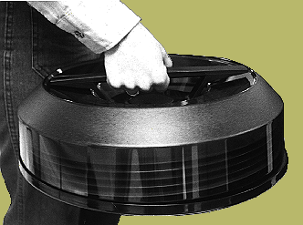
Outsourcing
TRUST?
Manufacturing
Software development
Service
Data

Slide 3
Data Outsourcing Model
Owner: owns data
Servers: host (or process) the data and provide query services
Clients: query the owner’s data through servers
(possibly = owner) the unified client model
clients
/
servers
owner

Slide 4
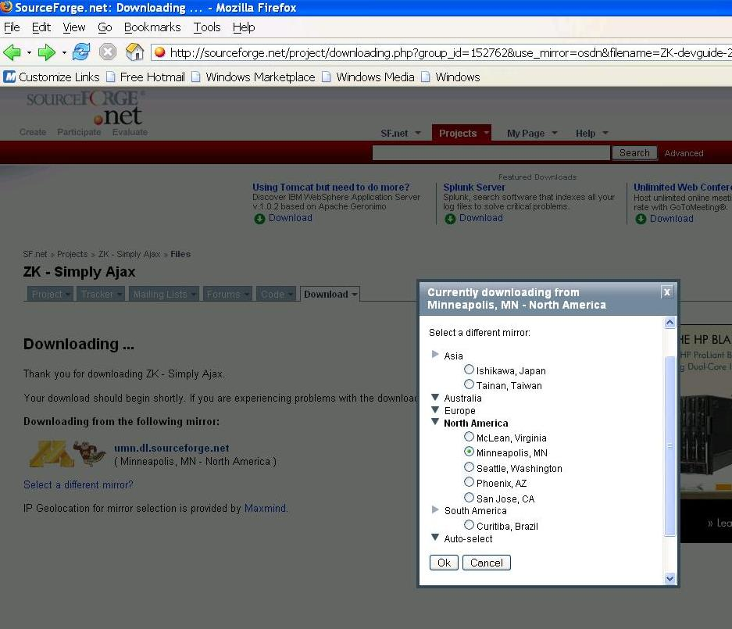
Outsourced Database for Better Query Services
Company with headquarters in US
Servers that are close to local clients and
maintained by local business partners
4
Notes:
4

Slide 5
Data Outsourcing Model
Owner/client: owns data and issue queries
Servers: host (or process) the data and provide query services
the unified client model
Owner/client
servers
5
Notes:
5

Slide 6
Model Comparison
 | 3-party model | 2-party model
Model | One data owner, a few servers, many clients | One data owner/client, one server
Motivation | Better serve clients in different locations | Owner does not have enough resources
Client | Client does not have access to data | Client has access to data
Techniques | Digital signatures, one-way hash functions, Merkle hash trees, etc. | ?
Previous work | Lot | Few

Slide 7

Data Stream Outsourcing
Network
0 1 1 0 0 1 … 1 1 0 …
IP Traffic Stream
coming from small business
Gigascope:
analysis tool by
Results
statistics

Slide 8
Concrete Example
IP Stream:
p_{m}
. . .
p₃
p₂
p₁
: srcIP, destIP
SELECT COUNT(*) FROM IP_trace
GROUP BY srcIP, destIP
Answer:
Groups
1 | 2 | 3 | . . . | n
1,540 | 5,356 | 150 | . . . | 8,794

Slide 9
The Model for the Stream
T=1
T=2
T=3
S
1
i
1
…
group_id
Major issue: space
V
0
1
2
0
0
…
0
1
0
V₁
V₂
V₃
V_{i}
V_{n}

Slide 10
Information Security Issues
The third-party (server) cannot be trusted
  Lazy service provider
  Malicious intent
  Compromised equipment
  Unintentional errors (e.g. bugs)

Slide 11
A Simple Solution [Sion, VLDB 05]
Accumulate b queries
The owner computes r of them itself
Compute the hashes of these results, with some fake ones
Ask the server to identify these r queries
Problems:
  Can only prevent (very) lazy service provider
    How about malicious attacks?
  Need to accumulate enough queries
    What if there is only one query?
  High cost: r queries need to processed locally
  High failure probability: 10%-30% (typically)

Slide 12

Continuous Query Verification: CQV
T=1
T=2
T=3
S
9
7
1
…
Update X
Update V
V
0
9
2
0
0
…
0
1
0
X^{T}
V₁
V₂
V₃
V_{i}
V_{n}
Synopsis
0
9
2
0
2
…
0
2
0
0
5
0
…
1
0
V₁
V₂
V₃
V_{i}
V_{n}
V₁
V₂
V₃
V_{i}
V_{n}
Alarm
no alarm

Slide 13
PIRS: Polynomial Identity Random Synopsis
choose prime p:
chose a random number :
raise alarm if not equal
o/w no alarm

Slide 14
Incremental Update to PIRS
T=1
T=2
S
1
i
…
update to v₁
update to v_{i}

Slide 15
It Solves CQV problem!
Theorem: Given any
PIRS raises an alarm
with probability at least 1-δ, otherwise no alarm.
a polynomial with 1 as the leading coefficient is completely determined
by its zeroes (and the corresponding multiplicity)
happens at no more than m values of x
due to the fundamental theorem of algebra.
Since we have p>m/ δ choices for a:
the probability that X(V)=X(W) is at most δ

Slide 16
Optimality of PIRS
Theorem: PIRS occupies O(log(m/δ) + log n) bits of space
(3 words only at most, i.e., p, a, X(V)), spends O(1) time to
process a tuple for count query, or O(log u) time to process
a tuple for sum query.
Theorem: Any synopsis for solving the CQV problem with
error probability at most δ has to keep Ω(log(min{n,m}/δ)) bits.

Slide 17
In Practice
Failure probability
  Choose largest p that fits in a word
  E.g, if we use 64-bit words, then failure probability is δ = m/p < 2⁻³² (assuming m<2³²)
Space requirement
  p, a, X(V): 3 words!
Time requirement
  For count queries / selection queries
    One subtraction, one multiplication, one mod
  For sum queries:
    log(u) multiplications: exponentiation by squaring

Slide 18
Multiple Queries
Q₁
Q₂
Q₁
Q₂
V_{1..n1}
V_{1..n2}
V_{1..(n1+n2)}
X₁
X₂
X
Theorem: our synopses use constant space for multiple queries.
S
1,8
…
update to v₁
update to v₈

Slide 19
Some Experiments
We use real streams:
  World Cup Data (WC)
  IP traces from the AT&T network (IP)
We perform the following query:
  WC: Aggregate on response size and group by client id/object id (50M groups)
  IP: Aggregate on packet size and group by source IP/destination IP (7M groups)
Hardware for the client:
  2.8GHz Intel Pentium 4 CPU
  512 MB memory
  Linux Machine

Slide 20
Memory Usage of Exact
Exact’s memory usage is linear and expensive.
PIRS using only constant 3 words (27 bytes) at all time.

Slide 21
Update Time (per tuple) of Exact
Cache misses
Exact is fast when memory usage is small.
It becomes extremely slow due to cache misses.

Slide 22
Running Time Analysis
Average Update Time
 | WC | IPs
Count | 0.98 μs | 0.98 μs
Sum | 8.01 μs | 6.69 μs
IPs exhibits smaller update cost for sum query as the average value of u is smaller than that of WC

Slide 23
Multiple Queries: Exact Memory Usage
Exact’s memory usage is linear w.r.t number of queries and increasing over time.
PIRS always uses only 3 words.

Slide 24
CQV with Load Shedding
24
Notes:
24

Slide 25
PIRS^{γ:} An Exact Solution
b_{i}=2
Alarm
v_{i}
If at least one layer raises alarms
…
PIRS
PIRS
PIRS
k buckets
Alarm
log 1/δ
…
If at least γ buckets raise alarms
…
PIRS
PIRS
PIRS
25
Notes:
25

Slide 26
PIRS^{γ:} An Exact Solution
Theorem: PIRS^{γ} requires O(γ² log1/δ logn) bits, spends
O(γ log1/δ ) time to process a tuple and solves CQV
with semantic load shedding.
26
Notes:
26

Slide 27
Intuition on Approximation
the approximation
probability to raise alarm
the ideal synopsis
number of errors
γ-
γ
γ+
27
Notes:
27

Slide 28
PIRS^{±γ:} An Approximate Solution
Theorem: PIRS^{±γ} requires O(γ log1/δ logn) bits, spends
O(γ log1/δ ) time to process a tuple.
28
Notes:
28

Slide 29
PIRS^{±γ:} An Approximate Solution
Theorem: PIRS^{±γ}: 1.raises no alarm with probability
at least 1- δ on any
2.raises an alarm with probability at least 1- δ on any
For any c>-lnln2=0.367
Using the intuition of coupon collector problem
and the Chernoff bound.
29
Notes:
29

Slide 30
PIRS^{±γ:} An Approximate Solution
Alarm
If majority layers raise alarms
b_{i}=2
v_{i}
…
PIRS
PIRS
PIRS
k buckets
Alarm
log 1/δ
…
If all k buckets raise alarms
…
PIRS
PIRS
PIRS
30
Notes:
30

Slide 31
PIRS^{±γ}: Experiments

Slide 32
Related Techniques to PIRS
Incremental Cryptography
  Block operation (insert, delete), cannot support arithmetic operation
Sketches
  Provide approximate estimates
    We want absolute accuracy
  Often much more costly
    Space O(1/) or O(1/²)
Fingerprinting Technique
  PIRS is a fingerprinting technique
  Polynomial identity verification
32
Notes:
32

Slide 33
Thanks!
Questions

