Slide 1
Web Application for Real-time Forex Rate and Stock Price Prediction
HKUST FYP Group RO5
HO Cheuk Yin (Ronald)
WONG Hoi Ming (Henry)

Slide 2
Overview of today’s presentation
Introduction, Design and Implementation
(10 - 15 mins)
Demonstration
(5 - 10 mins)
Performance Evaluation and Conclusion
(5 mins)
Q & A
(10 mins)

Slide 3
Background of our project
Both stocks and foreign currencies (forex) are ubiquitous!
Purchase forexes when travelling to other countries
Fluctuation in forex rates impact the prices of imported goods and cost of living!
Transaction of forexes and stocks for investment purposes!

Slide 4
Background of our project
If future prices and price trends can be predicted…
Investors: Make better decision and (hopefully) gain in returns!
Governments: Make more accurate policies to stabilize their currencies!
General public (you and me): Reduce cost of travelling and living!

Slide 5
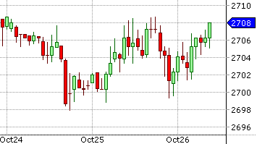
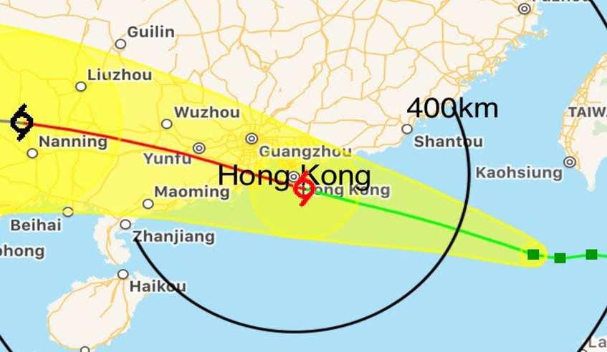
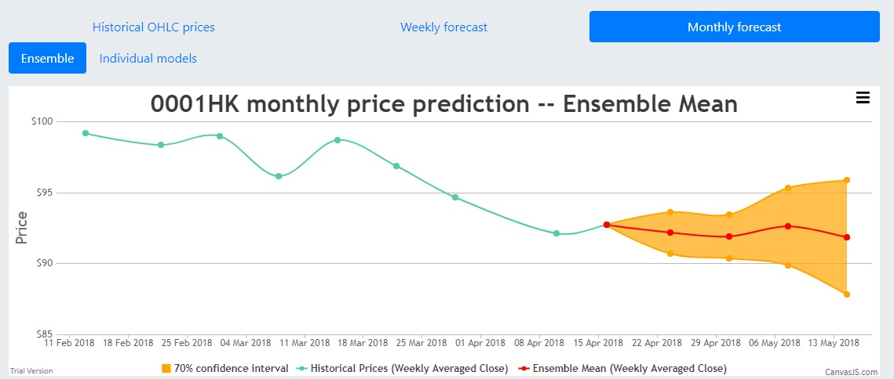
Objective and Goal
Objective of our web application:
Build an online system to predict the long-term rise/fall trend and short-term prices of various most traded forex and stock, based on statistical indicators.
Build a user-friendly web application that allows users to view prediction results and visualize the trends via charts.
Provide the 70% confidence interval of short term price predictions and the probability of prediction confidence for long term price trend prediction.

Slide 6
Objective and Goal
In one sentence:
To provide short term price prediction and long term price trend prediction in a user-friendly approach
How?

Slide 7
Defining Prediction Goals
Short term / Long term
Terms | Corresponding Time period | Corresponding business days
Short term | Weekly | t + 1, t + 2, … , t + 5
Short term | Monthly | t + 5, t + 10, … , t + 20
Long term | Monthly | t + 20
Long term | Quarterly | t + 60

Slide 8
Defining Prediction Goals
Price Predictions / Price Trend Predictions
Price Predictions : Predict prices for each business day within next week
(t + 1,…,t + 5)
weekly average prices for every week within next month
(t + 5, t + 10, … , t + 20)
Price Trend Predictions: Predict whether the Simple Moving Average (SMA) of specified time period ahead is greater than the SMA of latest business day
$$SMA\left(t, n\right)=\frac{P_{t−n}+P_{t−n+1}+ …+P_{t−1}+P_{t}}{n}$$
Upward trend for n business days = SMA(t + n, n) – SMA(t,n) > 0
Downward trend for n business days = SMA(t + n, n) – SMA(t,n) < 0

Slide 9
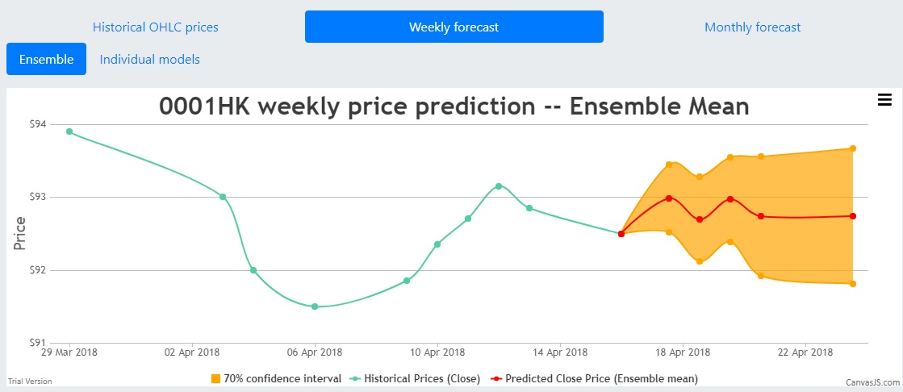
Defining Prediction Goals
Price predictions:
Weekly price prediction
Monthly price prediction

Slide 10
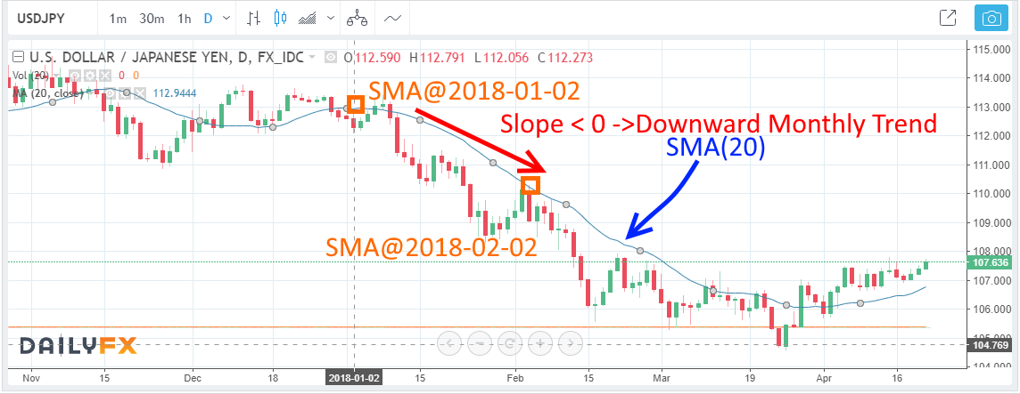
Defining Prediction Goals
Trend definitions (example of downward monthly trend):

Slide 11
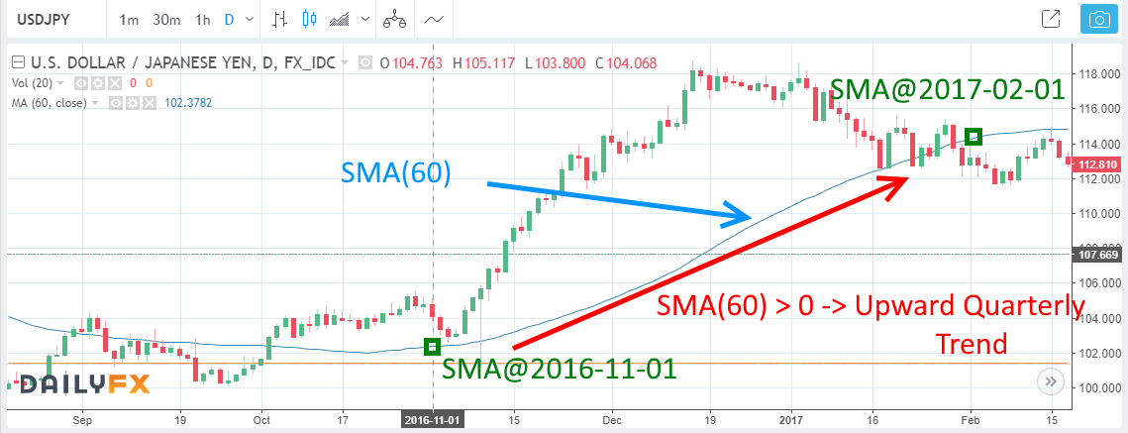
Defining Prediction Goals
Trend definitions (example of Upward quarterly trend):

Slide 12
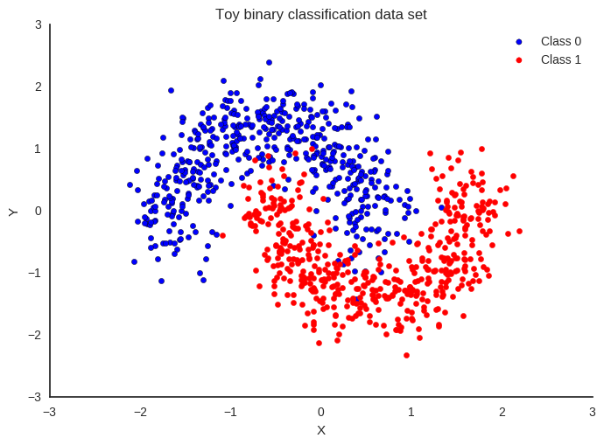
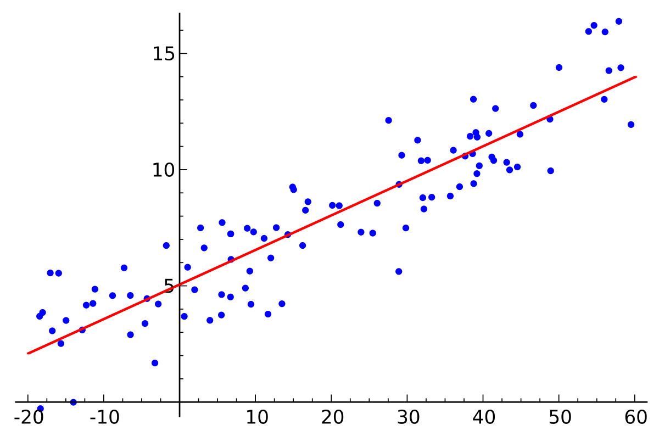
Defining Prediction Goals
With the prediction goals defined in previous slides, the prediction tasks for our web application can be defined as:
Binary classification (Monthly and Quarterly trends)
Regression (Weekly and Monthly price predictions)

Slide 13
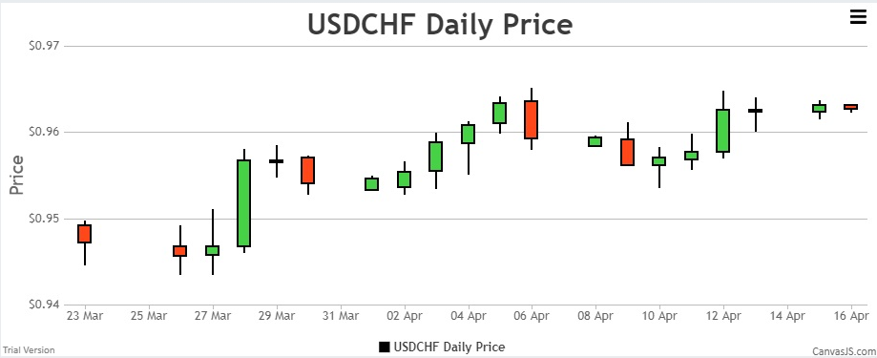
Defining Prediction Goals
User-friendly Approach
The users of our web application can intuitively interpret the prediction results.

Slide 14
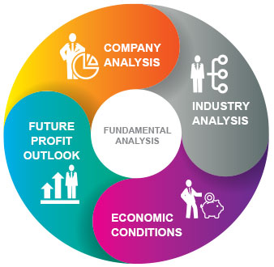
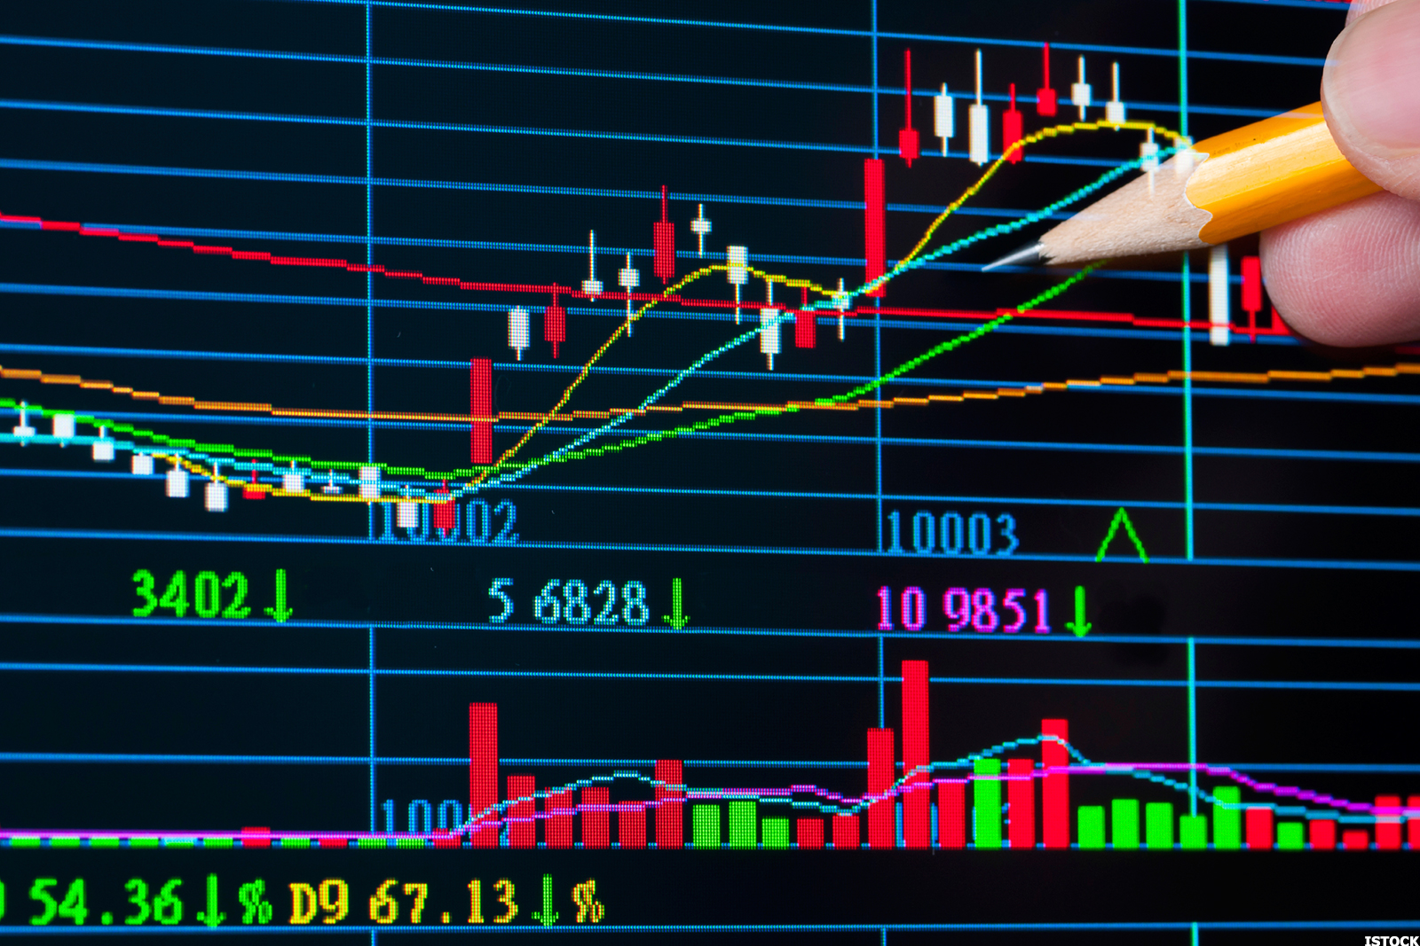
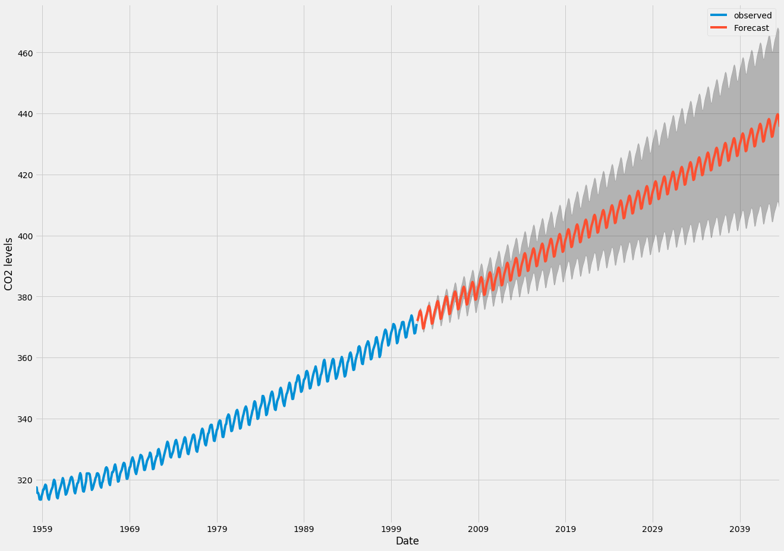
Literature Survey/related methodologies
Previous methodologies for predicting stock prices and forex rates:
Fundamental Analysis
Technical Analysis
Time Series Predictions

Slide 15
Comparison between different methodologies
 | Advantages | Disadvantages
Fundamental Analysis | Take the external factors other than price into account Able to predict long term trend | Tend to ignore drastic / short term price movement and unable to predict short term fluctuation of prices Complicated to perform and extract data
Technical Analysis | Analysis can be quantified by technical indicators Can be easily implemented and interpreted | Some aspects seem to be subjective and complicated to implement (e.g. chart patterns)
Time series Forecasting | Easy to implement Able to forecast periodical motion if exists | Simplified predictions tend to overlook external factors. Complicated transformation for non-stationary time series

Slide 16
Stocks and forex included in our web application
Stock Code | Name | Corresponding aspect as the constituent of HSI
5 | HSBC Holdings | Finance
2388 | BOC Hong Kong | Finance
388 | HKEX | Finance
2 | CLP Holdings | Utilities
836 | China Res Power | Utilities
4 | Wharf Holdings | Properties
2007 | Country Garden | Properties
1 | CKH Holdings | Commerce & Industry
700 | Tencent | Commerce & Industry
992 | Lenovo Group | Commerce & Industry
Forex currency pairs | Market Share % in 2016
USD/EUR | 23.1%
USD/JPY | 17.8%
USD/GBP | 9.3%
USD/AUD | 5.2%
USD/CAD | 4.3%
USD/CNY | 3.8%
USD/CHF | 3.6%
USD/MXN | 1.8%
USD/SGD | 1.6%
USD/KRW | 1.5%

Slide 17
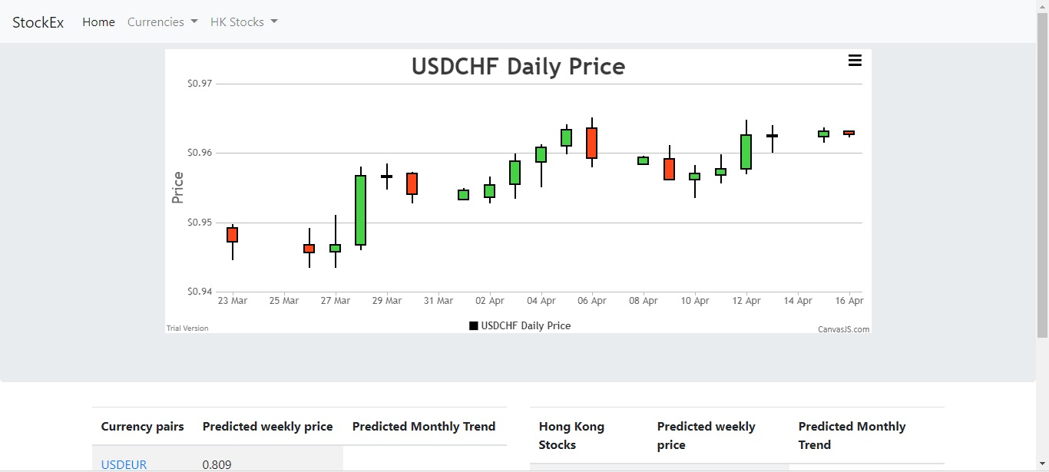
Design and general workflow of our web application
Local Storage of web server
⑧ Display rendered pages
⑥ Send back requested Data
⑦ JSON responses
③ Request data
⑤
Download latest Prices Daily
① Access
② Make “GET” requests
Web server
Users
Web UI
④ Download if not exists
Internet data
sources

Slide 18
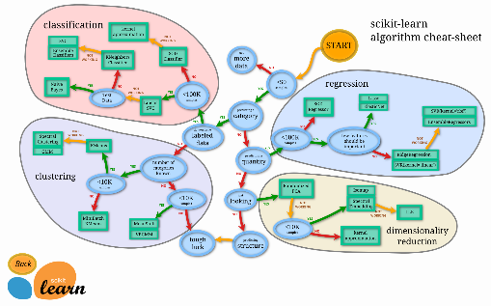
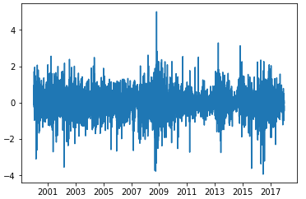
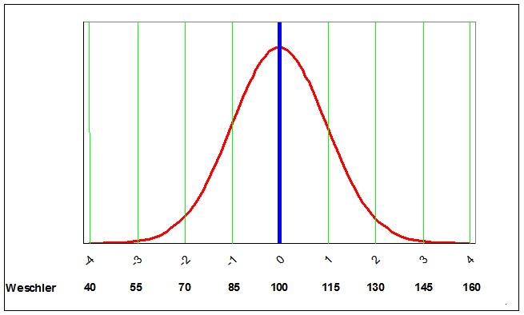
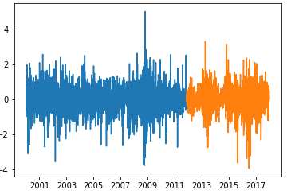
Work flow of constructing prediction models (Regression)
⑦ Performance Evaluation
⑥ Models Training
① Download data
③ Train test split (66%:33%)
⑤ Scaling by Standardization
② Transformation to stationary wave
④ Stacking

Slide 19
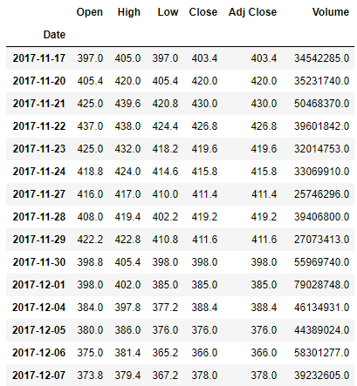
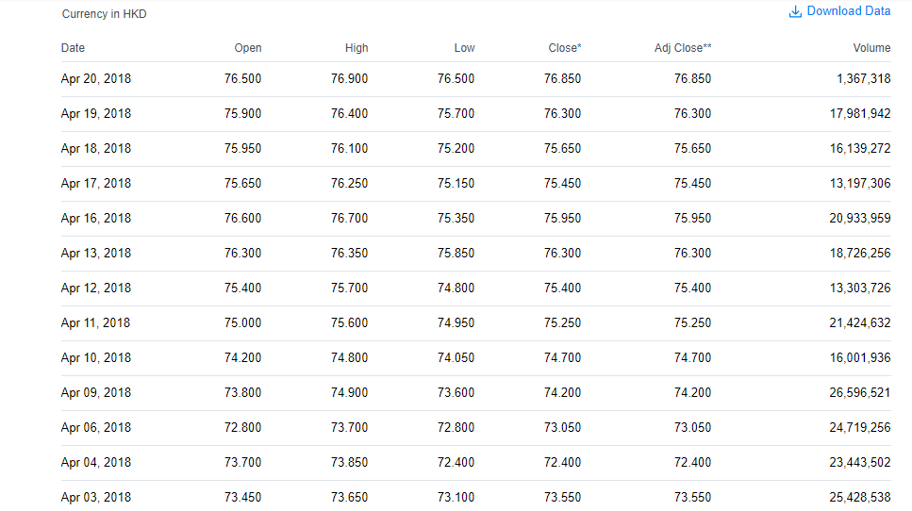
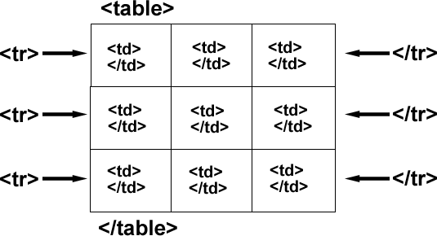
Data Scraping of price data
Get html pages from data sources
(Stock: Yahoo Finance,
Forex: Investing.com)
Scrape and parse price data inside the html table elements
Transformed into data frame / csv format for further usages / storages

Slide 20
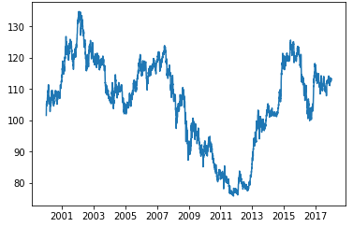
Transformation to stationary wave
Necessary for trend removal in performing time series predictions.
First-order differencing ($s=P_{t} −P_{t−1}$) was used in this project.

Slide 21
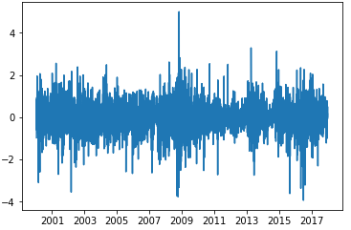
Train Test split
All price series started from 1 January 2000 to 31 December 2017
Train ratio: 66% : 33%.
Train sets: From 1 January 2000 to the year of 2012
Test sets: From the year of 2012 to 31 December 2017

Slide 22
Stacking of training sets and test sets
The training sets and test sets of all stocks/forex will be stacked together to form combined training sets and combined test sets
USDAUD training set
USDAUD
USDCAD
USDCAD
Training set
…
…
USDSGD
USDSGD
Training set

Slide 23
Stacking of training sets and test sets
Reasons:
To provide a much larger size of data for training/validation (3000 for individual stocks/forex vs 30000 for combined dataset)
The past data from other stocks/forex can be used to improve
prediction accuracy of any individual stocks / forex

Slide 24
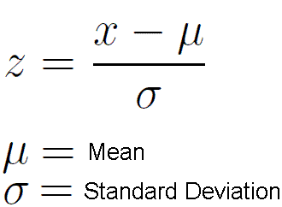
Feature Scaling by Standardization
Feature Scaling is necessary for ensure the features inside the combined training sets have similar scales.
USDAUD
USDCAD
…
USDSGD

Slide 25
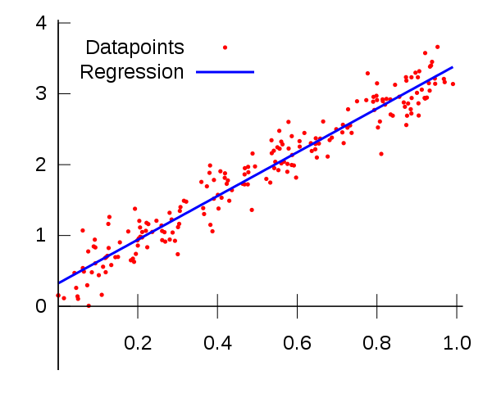
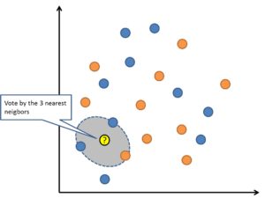
Training of Prediction Models (Regression)
Recurrent Neural Network (LSTM)
Random Forest (100 trees)
K nearest neighboring (k=5)
Linear Regression

Slide 26
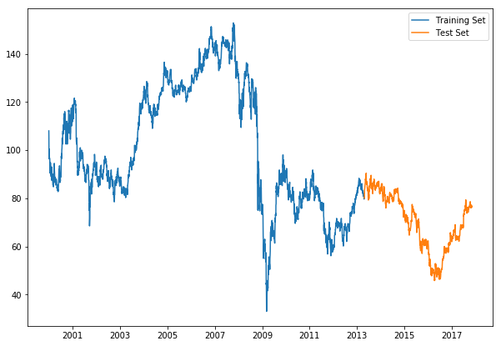
Work flow of constructing prediction models (Classification)
⑦ Performance Evaluation
⑥ Models Training
① Download data
③ Train test split (66%:33%)
⑤ Scaling by Standardization
②Feature Generation
④ Stacking

Slide 27
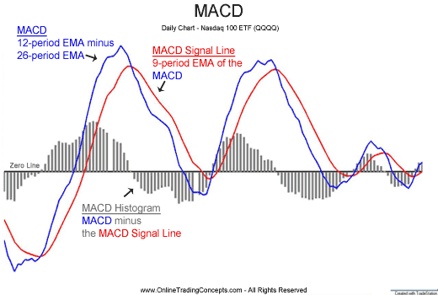
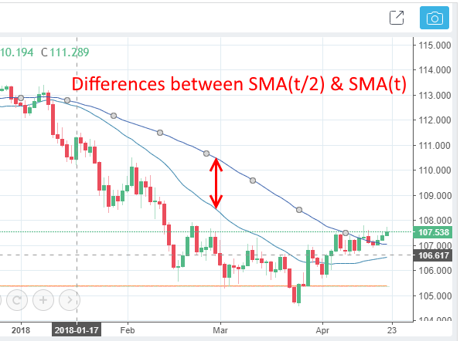
Feature generation for Classification
The following features have been generated based on historical prices:

Slide 28
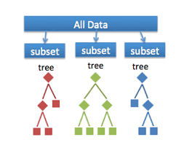
Prediction model of price trend prediction
Random forest model has been constructed to perform price trend prediction.

Slide 29
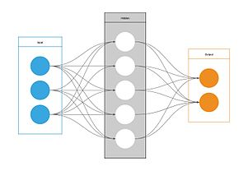
How do we implement these features?

Slide 30
Demonstration of our web application

Slide 31
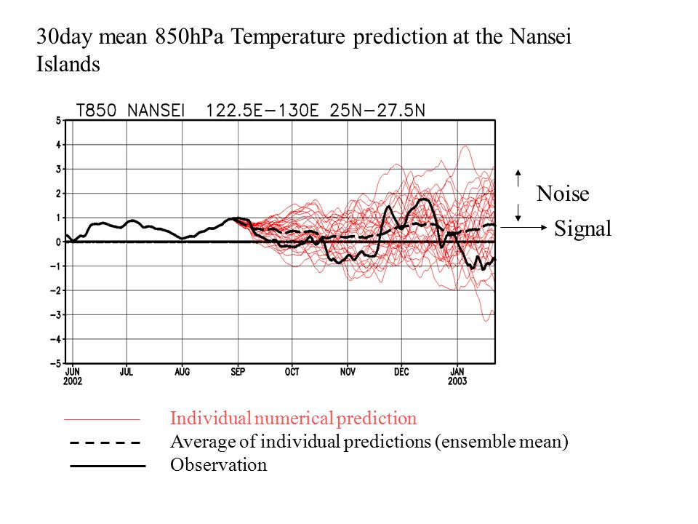
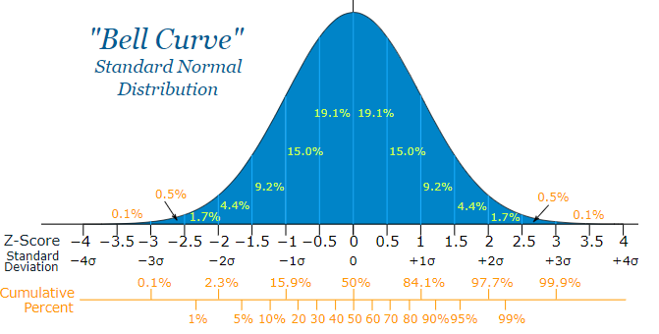
Construction of 70% confidence interval
The 70% confidence intervals were constructed based on individual decision tree inside the random forest model
Assumption: normal distribution of predictions
Within 1.04 SD of the predicted mean corresponds to around 70% of all predicted data.

Slide 32
Prediction performance evaluations
Metric for regression models: Mean absolute percentage error (MAPE)
$MAPE=\frac{100}{n}\sum_{t=1}^{n}{\left|\frac{{Pt}_{actual}−{Pt}_{predicted}}{{Pt}_{actual}} \right|}, Pt=price at time t$
Metric for classification model: Accuracy
$Accuracy=\frac{number of correct predictions}{total number of predictions}∗100 \%$

Slide 33
Prediction performance evaluations
The MAPE of weekly price predictions for stocks:
Model\Time | +1 business day | +2 business day | +3 business day | +4 business day | +5 business day
Random Forest | 1.185% | 1.741% | 2.150% | 2.508% | 2.812%
Recurrent neural networks | 1.366% | 2.017% | 2.488% | 2.861% | 3.162%
K nearest neighboring | 1.234% | 1.806% | 2.231% | 2.602% | 2.932%
Linear regression | 1.162% | 1.698% | 2.104% | 2.464% | 2.776%
Mean MAPE | 1.237% | 1.816% | 2.243% | 2.609% | 2.921%

Slide 34
Prediction performance evaluations
The MAPE of weekly price predictions for forex:
Model\Time | +1 business day | +2 business day | +3 business day | +4 business day | +5 business day
Random Forest | 0.377% | 0.534% | 0.663% | 0.768% | 0.862%
Recurrent neural networks | 2.014 % | 1.951% | 2.345% | 6.921% | 2.374%
K nearest neighboring | 0.397% | 0.556% | 0.687% | 0.793% | 0.888%
Linear regression | 0.378 % | 0.539% | 0.672% | 0.785% | 0.887%
Mean MAPE | 0.792% | 0.895% | 1.092% | 2.317% | 1.253%

Slide 35
Prediction performance evaluations
The MAPE of monthly price predictions for stocks:
Model\Time | +1 week | +2 week | +3 week | +4 week
Random Forest | 2.345% | 3.818% | 4.931% | 5.835%
Recurrent neural networks | 2.892% | 4.432% | 5.653% | 6.915%
K nearest neighboring | 2.649% | 4.310% | 5.506% | 6.479%
Linear regression | 2.308% | 3.740% | 4.816% | 5.712%
Mean MAPE | 2.549% | 4.075% | 5.227% | 6.235%

Slide 36
Prediction performance evaluations
The MAPE of monthly price predictions for forex:
Model\Time | +1 week | +2 week | +3 week | +4 week
Random Forest | 0.728% | 1.164 % | 1.475% | 1.714%
Recurrent neural networks | 6.012% | 7.824% | 5.246% | 9.670%
K nearest neighboring | 0.818% | 1.320% | 1.674% | 1.959%
Linear regression | 0.733% | 1.162% | 1.463% | 1.802%
Mean MAPE | 2.073% | 2.868% | 2.465% | 3.786%

Slide 37
Prediction performance evaluations
The accuracy of trend predictions in various time period:
Type of asset\ Time period of prediction | Monthly | Quarterly
Stock | 73.9% | 76.1%
Forex | 73.2% | 77.2%

Slide 38
Result implications
Forex in general have much lower prediction errors than stocks
Random forest and Linear regression perform much better than recurrent neural network and k nearest neighboring in price predictions
For trend predictions, the accuracy of the random forest model is much higher than random guessing
(~75% vs 50%)

Slide 39
Conclusion
We have developed a web application be able to achieve the following objectives:
Build an online system to predict the long-term rise/fall trend and short-term prices of various most traded forex and stock, based on statistical indicators.
Build a user-friendly web application that allows users to view prediction results and visualize the trends via charts.
Provide the 70% confidence interval of short term price predictions and the probability of prediction confidence for long term price trend prediction.

Slide 40
Conclusion
However, we believed that continuous improvements are necessary for any software, including our web application.
There are several points we would like to suggest for further improvement of this web application and the development of other related applications.
Deployment of the web application towards real production environment
Extension towards other types of financial assets, including encrypted currencies (for example, Bitcoin), Gold, Oil and etc.
Integration of prediction models with sentiment/textual analysis of social media (for example, twitter, Facebook) and financial news articles.

Slide 41
The end!
Thank you!

